Slide 1
Multi Layer Perceptron Bryn Webb

Slide 2


Data Set Aids Clinical Trial 175 2139 Instances 23 Features Categorical and Integer Features 2 Classifications

Slide 3
Multi-layer Perceptron
A type of artificial neural network
Not really a perceptron, actually an Adaline
Minimizes Mean Square Error instead of misclassification
2 Main functions
Forward and Backward
Uses a sigmoid regression function

Slide 4
Initialization Weights – random floats between -1 and 1, normalized on 0 Bias - 0

Slide 5
Forward Method
Hidden layer
Output layer
Z_h = X * W_h + b_h
X is the input feature matrix
W_h is the hidden layer weights
B_h is the hidden layer bias
Activation:
A_h = sigmoid(Z)
A_h has dimensions n X d
(d is the number of nodes in the hidden layer)
Z_out = A_h * W_out + b_out
A_h is from the previous calculations
W_out is the output layer weights
B_out is the output layer bias
Activation:
A_out = sigmoid(Z)
A_out has dimensions n X t
(t is the number of nodes in the output layer)

Slide 6
Backward Method
Gradients of loss with respect to w:
∂L​
∂w
Find this by finding partial derivatives
Use gradients of loss to update weights
w ← w – η * ∂L​
∂w
Find Gradients of Loss
Calculate the gradient loss during backpropagation
L(θ): the loss function
Θ: the model parameters
w: a weight in the network

Slide 7
Training
For each epoch
Create small randomized batches
Run each batch through the forward method
Run each batch through the backward method with activation values from forward method
Update weights with learning rate * loss
Calculate MSE and accuracy

Slide 8
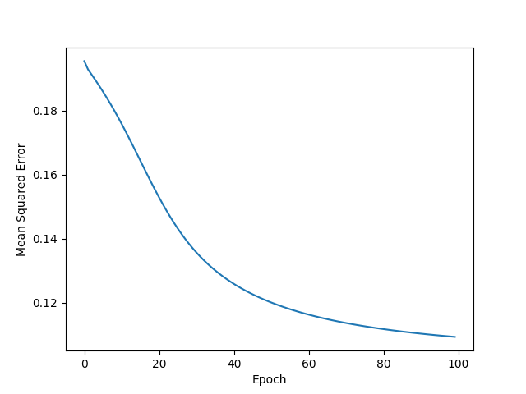
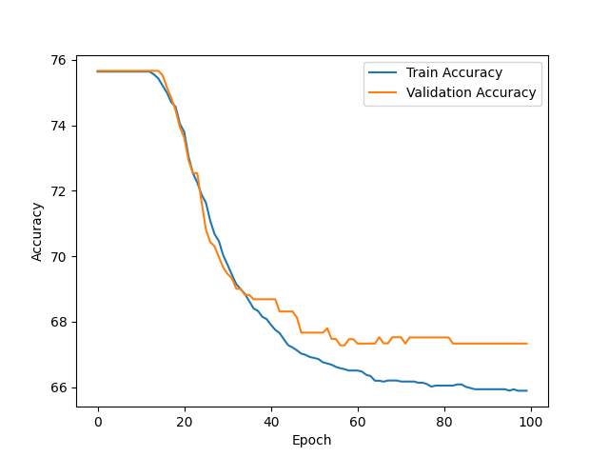
Results

Slide 9
Lessons Learned
Difference between MSE and Accuracy
Regression Models Minimize Loss
Classifiers minimize incorrect classifications
Importance of Understanding the Dimensions of each Matrix

